Slide 1
Visualizing Employee Attendance Trends with excel charts.
STUDENT NAME:KALAVATHY.M
REGISTER NO:312217120/ asunm1659312217120
DEPARTMENT:B.COM(CA)
COLLEGE:SHRI KRISHNASWAMY COLLEGE FOR WOMEN

Slide 2
PROJECT TITLE
Visualizing Employee Attendance Trends with excel charts.

Slide 3


AGENDA
Problem Statement
Project Overview
End Users
Our Solution and Proposition
Dataset Description
Modelling Approach
Results and Discussion
Conclusion
3/21/2024 Annual Review

Slide 4

PROBLEM STATEMENT
Objective: The primary objective of this project is to effectively visualize employee attendance data to identify trends, patterns, and insights that can aid in workforce management. This will involve the use of Excel charts to represent attendance data in a clear, concise, and easily interpretable manner.
Scope:
1.Data Collection and Preparation
2.Chart Selection and Design
3.Data Analysis
4.Visualization and Reporting:

Slide 5

PROJECT OVERVIEW
This overview should guide the project to a successful conclusion, ensuring that the final product is both informative and valuable to the organization.The goal of this project is to create a set of Excel charts that effectively visualize employee attendance trends. These charts will allow stakeholders to easily understand patterns, identify anomalies, and make informed decisions about workforce management.
.

Slide 6

WHO ARE THE END USERS?
•
The end users of visualising employee attendance trends with excel charts
1.Human Resources (HR) Managers HR
2.Team Leaders/Supervisors: Supervisors can
3.Operations Managers
4.Payroll Departments
5.Senior Management/Executives
6.Employees
7.Compliance Officers:

Slide 7

OUR SOLUTION AND ITS VALUE PROPOSITION
Solution overview: 1.Data Collection & Organization 2.Excel Chart Creation 3.Trend Analysis 4.DashboardsValue proposition : 1.Data-Driven Decision-Making 2.Improved Reporting 3.Employee Accountability 4.Efficiency & Accessibility By implementing this solution, organizations can gain better control over attendance management, ultimately leading to improved productivity, reduced absenteeism, and more strategic HR planning.

Slide 8
Dataset Description
Employe ID | Date | Attenders | Department | Shift
001 | 2024-8-1 | Present | Sales | Morning
002 | 2024-8-2 | Absent | HR | Evening
003 | 2024-8-3 | Late | IT | Night
004 | 2024-8-4 | Present | Sales | Morning
005 | 2024-8-5 | Present | HR | Evening
Employe ID | Date | Attenders | Department | Shift
001 | 2024-8-1 | Present | Sales | Morning
002 | 2024-8-2 | Absent | HR | Evening
003 | 2024-8-3 | Late | IT | Night
004 | 2024-8-4 | Present | Sales | Morning
005 | 2024-8-5 | Present | HR | Evening
The dataset used for visualizing employee attendance trends with Excel charts includes detailed records of employee attendance over a specific period. It contains columns such as employee ID, department, date, and status of attendance (e.g., present, absent, late, or on leave).
The dataset used for visualizing employee attendance trends with Excel charts includes detailed records of employee attendance over a specific period. It contains columns such as employee ID, department, date, and status of attendance (e.g., present, absent, late, or on leave)

Slide 9

THE "WOW" IN OUR SOLUTION
To effectively visualize employee attendance trends using Excel, you can create a combination of charts that provide clear insights. A "wow" solution would involve: 1.Line or Area Chart2.Heat Map3.Pivot Table with Bar/Column Chart4.Sparklines5.Dashboard This combination will provide a comprehensive, visually appealing overview of attendance trends, helping to identify patterns, anomalies, and areas for improvement
3/21/2024 Annual Review

Slide 10
MODELLING
Visualizing employee attendance trends in Excel can help you quickly understand patterns, identify issues, and make data-driven decisions. Tips: Regularly update your data to keep the charts and dashboards current. Use annotations in your charts to highlight significant trends or anomalies. Save different views of the data (monthly, quarterly, yearly) for comparative analysis. These steps will help you create insightful visualizations of employee attendance trends in Excel, aiding in better workforce management.

Slide 11
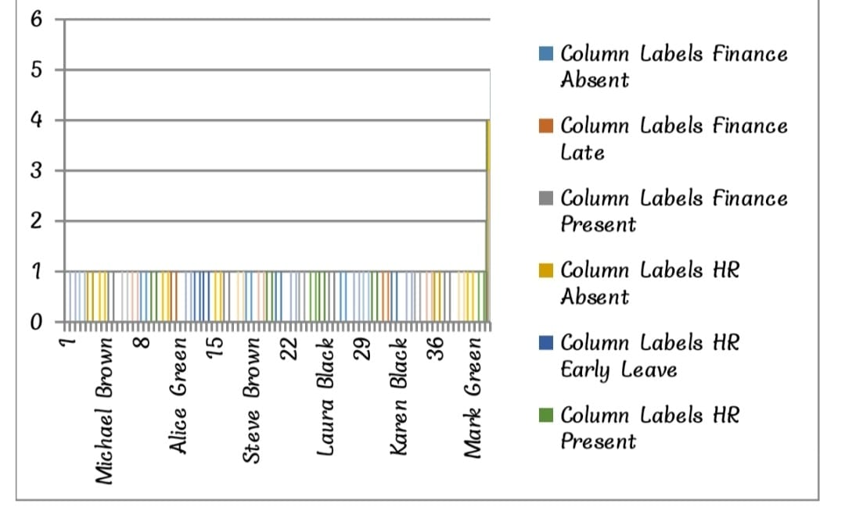
RESULTS

Slide 12
conclusion
Visualizing employee attendance trends with Excel charts provides a clear and efficient way to monitor and analyze attendance patterns. By using charts such as line graphs, bar charts, or heat maps, you can quickly identify trends, spot anomalies, and assess overall attendance performance. This visual representation helps in making informed decisions, managing resources effectively, and addressing attendance issues promptly.

